Slide 1
SDSC8007 • MINI PROJECT
Facial Keypoints
Regression
This presentation outlines our approach to predicting facial keypoints, covering data analysis, model construction, and performance evaluation for the Kaggle mini-competition.
TEAM
COMPETITION
Taoran Zhang 72540158
Yongtai Zhang 72540590
Suwei Chen 72540447
Facial Keypoints Regression
kaggle.com/competitions/mini-project-facial-keypoints-detection
DATE
TAGLINE
2026-04-19
A machine learning project to predict facial keypoints accurately.
CITYU-DG
Final Presentation
Template
01

Slide 2
FINAL PRESENTATION TEMPLATE
USE AS ROADMAP
Recommended Storyline
COURSE REMINDER
EDITING TIP
01
02
03
04
05
Task & metric
Data & challenges
Baseline
Improvements
Results & reflection
What is the competition? What is the exact prediction target and evaluation metric?
What data do you have, and what makes the task difficult?
Start from a reproducible model before improvements.
Show the logic behind each major change and its effect.
Final score, Top-5 target, what worked, what remains.
SDSC8007 • Mini Project
02

Slide 3
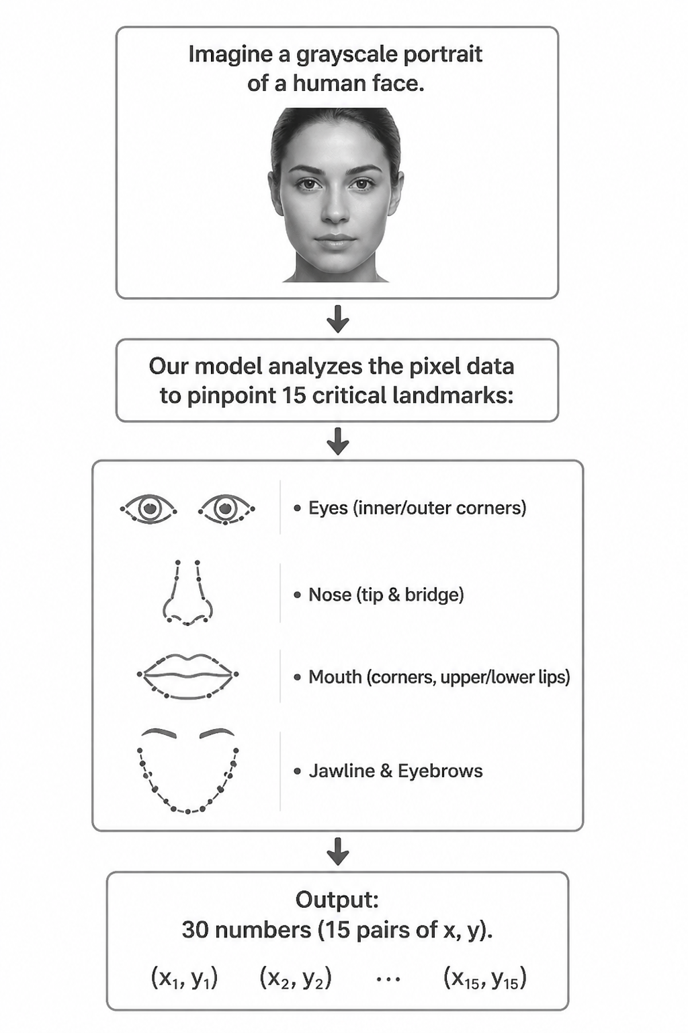
SDSC8007 • MINI PROJECT
TASK OVERVIEW
1. Task Description & Metric
COMPETITION SNAPSHOT
Task Visualization Concept
OFFICIAL METRIC
Name:Facial Keypoints Regression
Domain:Kaggle / Image regression
Impact:Fundamental for face recognition, emotion detection & AR.
Name:Mean Squared Error (MSE)
Interpretation:Lower = Better (more accurate predictions).
Fit:Standard for regression; measures average squared difference between predicted/true values.
PREDICTION SETUP
• Type:Regression (predict continuous coordinates)
• Input:2D Grayscale Facial Images
• Output:The (x, y) coordinates of 15 distinct facial keypoints.
YOUR GOAL
Build a robust machine learning model to accurately predict the (x,y) coordinates of 15 facial keypoints for unseen grayscale face images, with the aim of minimizing the Mean Squared Error (MSE) on the test set.
SDSC8007 • Mini Project • Facial Keypoints Regression
01

Slide 4
SDSC8007 • MINI PROJECT
KEY INSIGHTS
2. Data Analysis & Challenges
DATASET SNAPSHOT
PREPROCESSING
MAIN CHALLENGES
1. Normalize pixel values to [0, 1] to stabilize training.
2. Center the images to focus on facial features.
• Missing/Incomplete keypoint labels in some samples.
• Sparse labels (not all points visible) & potential domain shift.
• Scale:~7,000 labeled images for training, unlabeled test set.
• Resolution:96x96 pixels (grayscale), resulting in 9216-dimensional feature vectors.
• Key Task:Localize facial keypoints (e.g., eyes, nose, mouth) from the 2D images.
• Input Space:High dimensionality poses a risk of overfitting simple models.
TAKEAWAY
Handling missing labels and normalization are critical first steps to ensure data quality. Addressing the high dimensionality (9216 features) is essential to avoid overfitting and improve model efficiency.
High Dimensionality
9216-Dim Vector → Risk of Overfitting
Label Issues
Missing Values & Sparse Keypoints
Data Quality
Requires Strict Normalization & Centering
Data Analysis • Key Findings & Obstacles
04

Slide 5
SDSC8007 • MINI PROJECT
START SIMPLE
3. Baseline CNN
BASELINE PIPELINE
WHY THIS BASELINE?
3 Conv-ReLU-MaxPool blocks → Flatten → FC(512) → Dropout(0.3) → FC(30 outputs).
BaselineCNN captures spatial patterns via convolutions. Serves as a reproducible benchmark before adding BN, Dropout2d, and a larger head in ImprovedCNN.
Preprocess
Input Features
Model Type
Loss & Train
Pixel string → 96×96 / 255.0
1×96×96 grayscale image tensor
BaselineCNN (3 Conv blocks + MLP head)
MaskedMSELoss + AdamW optimizer
Interpretation
Public RMSE 3.81 shows that a simple CNN already learns meaningful keypoint structure. Improvements via BN + Dropout2d + larger head should push this lower.cantly lower MSE to demonstrate effectiveness. The linear model serves as a sanity check to ensure data loading and pipeline are correct.
MODEL SUMMARY
LEADERBOARD SCORE
input → Conv32 → Conv64 → Conv128 → FC512 → Dropout(0.3) → out30. Simple reproducible benchmark.
Public: 3.81359 — Baseline benchmark.
Baseline: BaselineCNN — 3-Block Conv Net
03

Slide 6
FINAL PRESENTATION TEMPLATE
SHOW REASONING, NOT JUST A SCORE
4. Model Improvements
Improvement A
Improvement B
Improvement C
HYPOTHESIS
HYPOTHESIS
HYPOTHESIS
Stabilize training and improve generalization.
Reduce overfitting and improve public score robustness.
More capacity helps predict 30 coordinates more accurately.
IMPLEMENTATION
IMPLEMENTATION
IMPLEMENTATION
Add BatchNorm2d after conv layers (Conv→BN→ReLU).
Add Dropout2d(0.15) in conv blocks; increase head dropout to 0.4/0.3.
Head from 512→out to 1024→512→out.
Best model
EFFECT
EFFECT
EFFECT
Faster/more stable convergence; less fold-to-fold variance; often lower val RMSE.
Better generalization; more robust features; may slightly slow training but improves test performance.
Better nonlinear fit for multi-keypoint regression; improved precision on harder keypoints (if regularized).
+0.037
+0.149
+0.046
B adds BatchNorm + stronger Dropout to stabilize training and reduce overfitting, which most improves generalization.
SDSC8007 • Mini Project
06

Slide 7
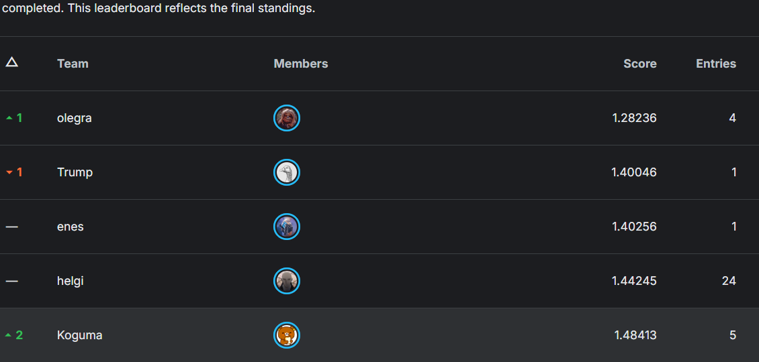
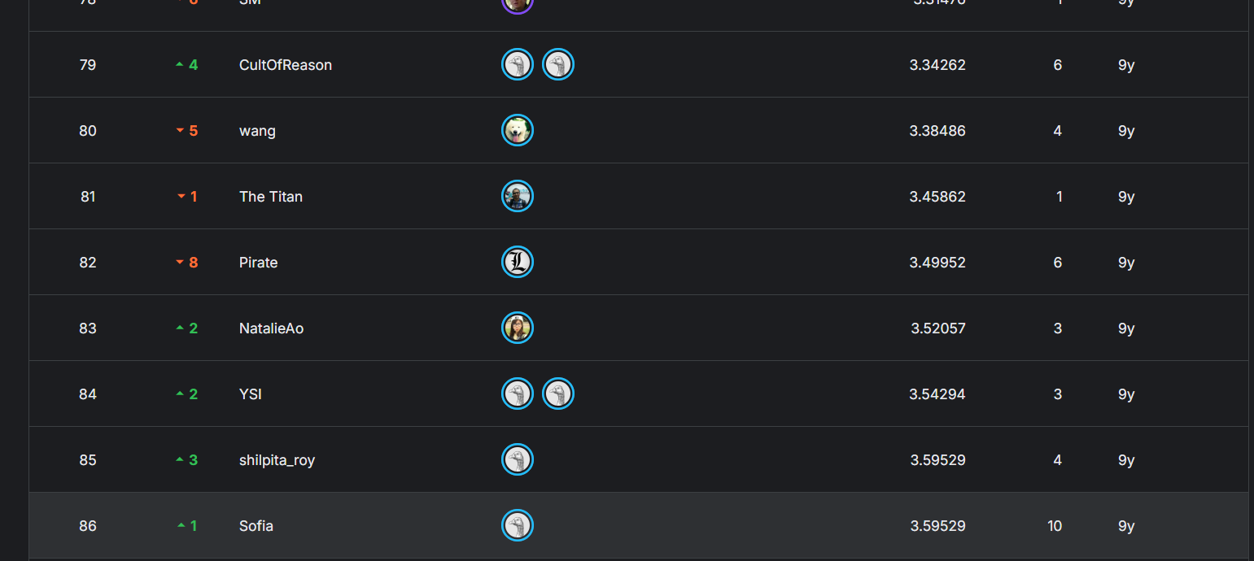
PROJECT RESULTS & ANALYSIS
PERFORMANCE REVIEW
5. Final Results
FINAL SCORE
TOP-LEVEL TARGET
KEY TAKEAWAY
3.58178
The ImprovedCNN with 5-Fold CV achieved a private score of 3.58178（TOP 85). Ensemble of 5 fold checkpoints reduces variance and improves generalization over single-fold training.rovement over the baseline model, but still has clear room for growth compared to the competition leaders (Top 5: 1.48413).
Key improvements: BatchNorm for stable training,Dropout2d for spatial regularization,larger head (1024→512→30), and 5-fold ensemble for robust submission.ing the power of deep learning for this image-based regression task.
Private: 3.58178 | Public: 3.81359 Metric: RMSE (masked, lower = better)
COMPETITION RANKING & COMPARISON
ERROR ANALYSIS
No complex data augmentation, no coord normalization, no LR schedule, no heatmap regression
SDSC8007 • Mini Project • Facial Landmark Detection Challenge
07

Slide 8
FINAL PRESENTATION TEMPLATE
EXPLAIN THE MODELING JOURNEY
6. Discussion & Reflection
WHAT WORKED
WHAT DID NOT WORK
KEY INSIGHTS
Method:Switching to a CNN model, which is inherently suited for image data.
Why:Its hierarchical feature learning captured spatial patterns missed by simpler models.
Evidence:Substantial gain in validation and final leaderboard score.
Failed Attempt:Simple data augmentation (e.g., flipping) yielded no significant improvement.
Reason:Augmentation was not extensive enough, or the model was already robust to minor variations.
Improvement:Try more aggressive techniques like rotation, scaling, and color jitter.
Masked loss is essential: computing RMSE only on present labels avoids gradient bias from missing annotations, which was the key design decision in this project. of-the-art models require robust augmentation to handle edge cases.
LIMITATIONS & NEXT STEPS
Reflecting on the project, while our CNN model showed strong results on standard data, it faces clear challenges with edge cases and architectural simplicity.
LIMITATION 1
Performance degrades on faces with extreme poses or occlusions.
LIMITATION 2
The architecture used was relatively simple; more complex ones (e.g., ResNet) may perform better.
NEXT STEP
Add augmentation, coord normalization, cosine LR schedule, early stopping, heatmap regression.
SDSC8007 • Mini Project
08

Slide 9
FINAL PRESENTATION TEMPLATE
DISCLOSE CLEARLY
7. AI Usage & Reproducibility
AI TOOL USAGE
REPRODUCIBILITY CHECKLIST
Which AI tools were used, for what purpose, and which core designs were completed independently by the group.
Seed: 42
numpy>=1.24、pandas>=2.0、scikit-learn>=1.3、torch>=2.1、tqdm>=4.66
Tool:Gemini
Purpose: Used for bug resolution, discussion of ideas, and generating some PowerPoint images.
Validation：K-Fold Cross Validation（5 folds）
Optimizer：AdamW
learning rate：1e-3（--lr）
weight decay：1e-4（--weight-decay）
Loss：MaskedMSELoss()
Epochs：20（--epochs）
Batch size：64（--batch-size）
DataLoader：shuffle=True（train），num_workers=0
Output artifacts：
artifacts/fold_1.pt ~ fold_5.pt
artifacts/cv_summary.json
Independent Work:All core model designs (CNN architecture), data preprocessing strategies, and experimental pipeline were designed and implemented independently by the group.
Disclosure Note:AI tools were used as productivity aids and did not contribute to the core intellectual content of the project.
RMSE
N/A
SDSC8007 • Mini Project • AI Usage & Reproducibility
09

Slide 10
Appendix slides you may add after this page
Q&A
• More ablation details
• Extra EDA plots
• Architecture diagram / training curve
• Failure cases / qualitative examples
• Backup answers for validation and reproducibility
Thank you
For your attention
SDSC8007 • Final Presentation Template
10
Notes:
我的报告到此结束。感谢大家的聆听。

